Slide 1


K.RAMAKRISHNAN COLLEGE OF ENGINEERING
(AUTONOMOUS)
VOICE-BASED TRANSPORT ENQUIRY SYSTEM
Presented by,
Name : THIRUPPATHI P
Register No. : 8115U24AM060
Roll No. : AM2460
Year : II /CSE(AIML)
Date of Review : 06/05/2026

Slide 2
PRESENTATION OVERVIEW
Objective
Introduction
Abstract
Architecture Diagram
Module Description
Implementation
Conclusion

Slide 3
OBJECTIVE
To develop a Voice-Based Transport Enquiry System that allows users to search transport details using speech input. To design and manage a structured database for storing routes, transport services, schedules, and fares efficiently. To provide a user-friendly interface that enables quick access to transport information with real-time results and easy navigation.

Slide 4
INTRODUCTION
To develop a centralized and user-friendly Voice-Based Transport Enquiry System that streamlines the process of accessing transport-related information—such as route searching, vehicle tracking, schedule viewing, and map-based navigation—in order to enhance accessibility, efficiency, and user interaction among system users.

Slide 5
ABSTRACT
The Voice-Based Transport Enquiry System is a digital platform designed to simplify and automate the process of accessing transport-related information. Traditionally, obtaining transport details such as routes, schedules, and fares involves manual searching or visiting multiple sources, which can become inefficient and time-consuming as travel demands increase.

Slide 6
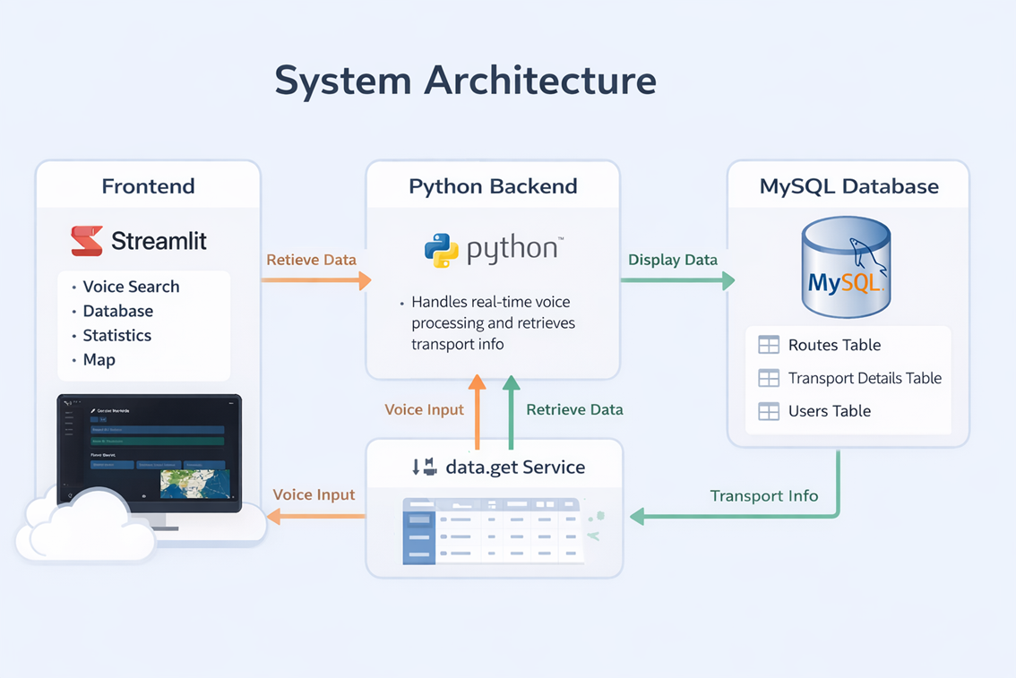
ARCHITECTURE DIAGRAM
.

Slide 7

MODULE DESCRIPTION
.
Voice Enquiry Module:
Search transport details using voice input.
Converts speech to text using speech recognition.
Extracts source and destination from spoken query.

Slide 8

2. Manual Enquiry Module
Enables users to manually enter source and destination.
Displays available transport options from the database.
Shows vehicle type, departure time, fare, and route details.
MODULE DESCRIPTION
.

Slide 9

MODULE DESCRIPTION
.
3. DBMS Analytics Module
Displays total routes and transport records.
Shows statistics such as average fare.
Tracks enquiry data and popular routes.

Slide 10

MODULE DESCRIPTION
.
4. Admin Control & Management Module
Provides centralized control for managing transport data.
Allows admin to update, add, delete data.
Manages routes, details, information of vehicles.

Slide 11
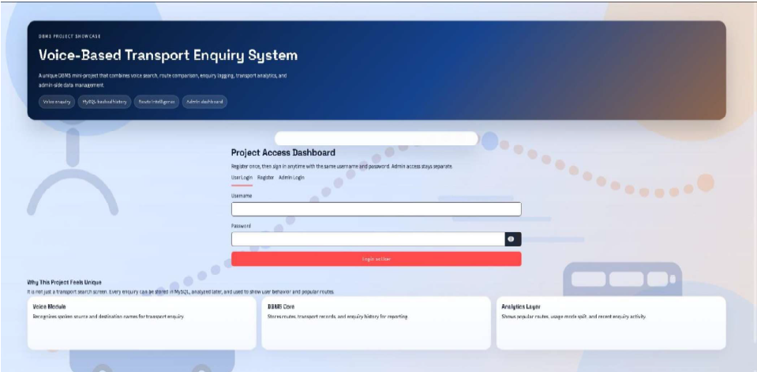
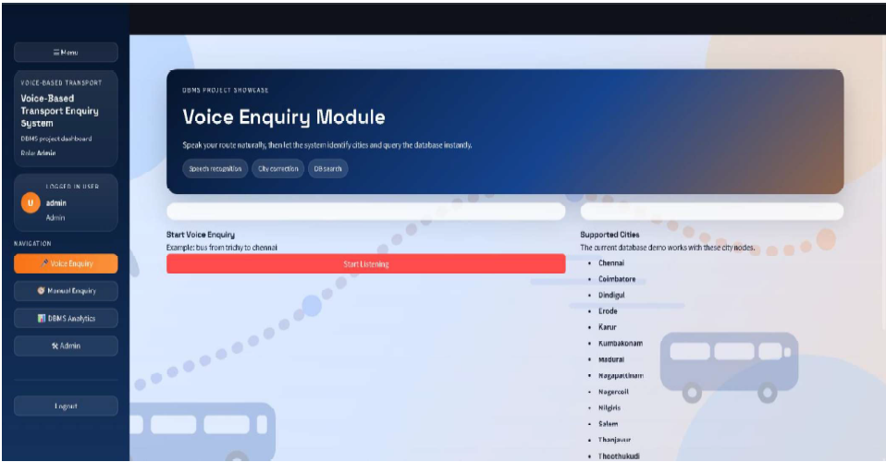
IMPLEMENTATION

Slide 12
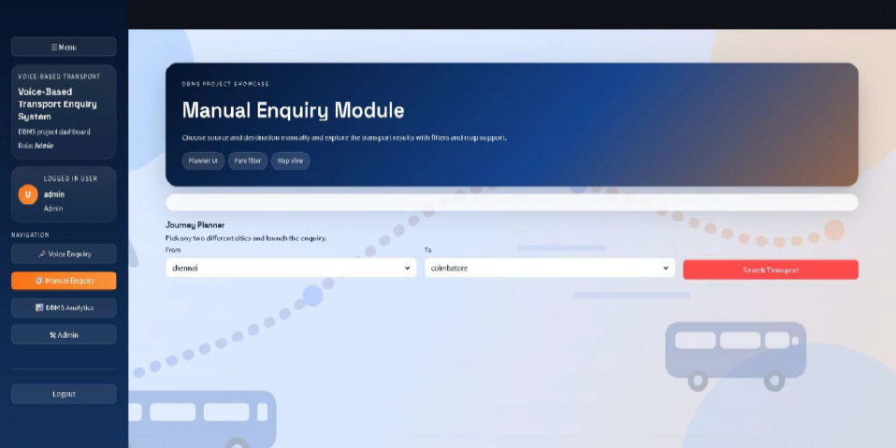
IMPLEMENTATION

Slide 13
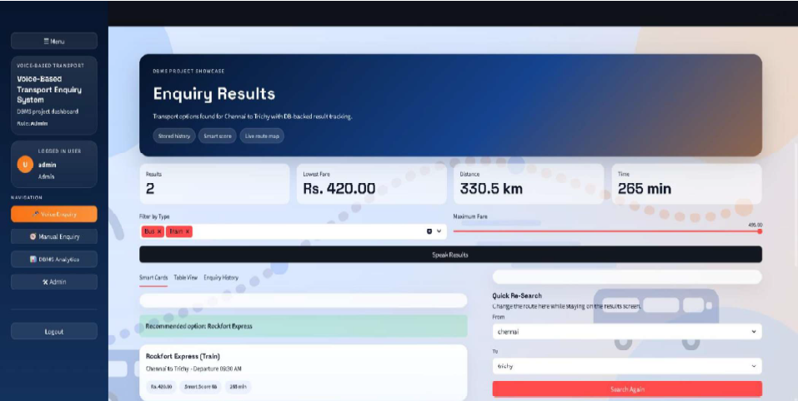
IMPLEMENTATION

Slide 14
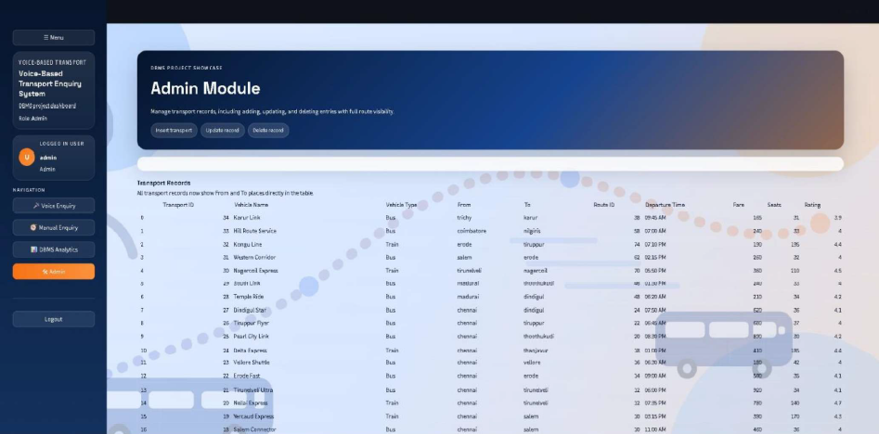
IMPLEMENTATION

Slide 15
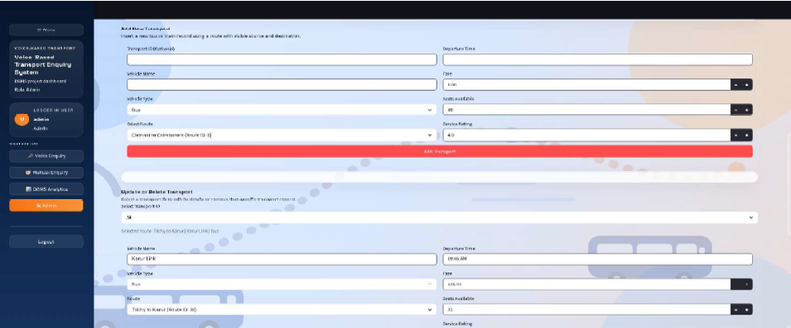
IMPLEMENTATION

Slide 16
CONCLUSION
The project provides a simple and interactive way to access transport information using voice input, improving user convenience. Integration with a structured database ensures fast retrieval of transport details like routes, timings, and fares. The system makes transport enquiry easier for all users, especially those with limited technical knowledge, through voice-based interaction.

Slide 17


